Slide 1
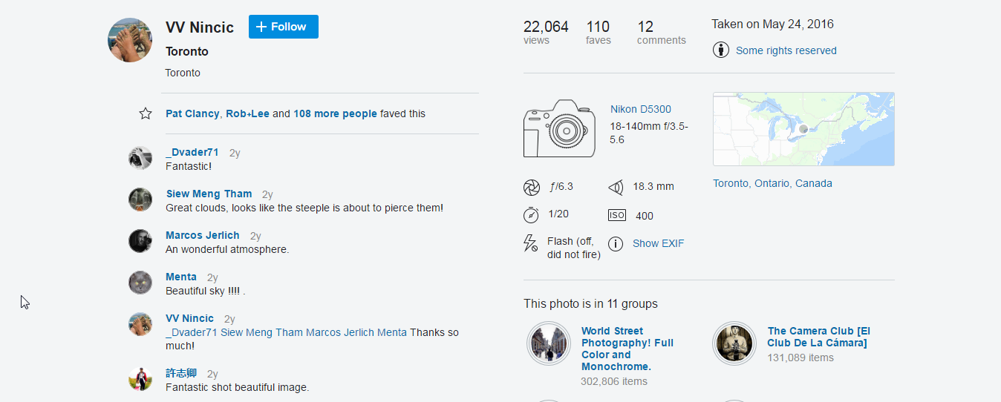
Views
Equipment
Camera settings
Geolocation
Detailed settings

Slide 2






Slide 3
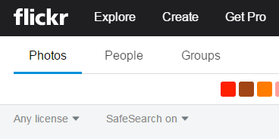
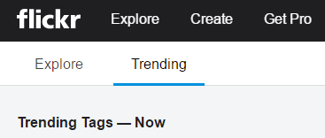
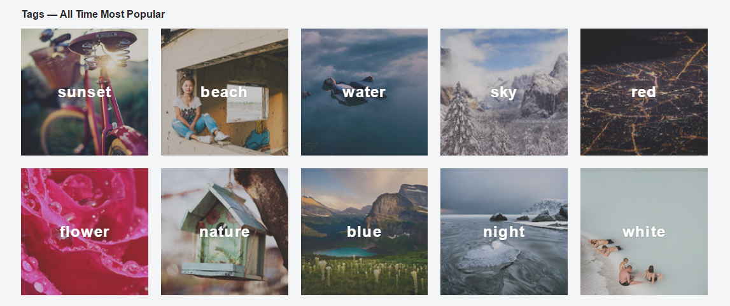

Slide 4
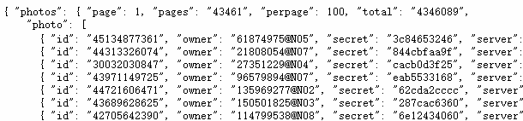





Total
Photo IDs

Slide 5










Cameras & Lenses
Geographical Distribution
JFIFVersion - 1.01
X-Resolution - 72 dpi
Y-Resolution - 72 dpi
Make - NIKON CORPORATION
Orientation - Horizontal (normal)
Software - GIMP 2.8.4
Date and Time (Modified) -2016:05:19 11:40:48
YCbCr Positioning - Centered
ISO Speed - 400
Exif Version - 0230
Date and Time (Original) -2016:05:16 19:56:04
Date and Time (Digitized) -2016:05:16 19:56:04
Components Configuration - Y, Cb, Cr, -
Compressed Bits Per Pixel - 4
Exposure Bias - 0 EV
Max Aperture Value - 3.5
Metering Mode - Multi-segment
Light Source - Unknown
Sub Sec Time - 60
Sub Sec Time Original - 60
Sub Sec Time Digitized - 60
Flashpix Version - 0100
Color Space - sRGB
Sensing Method - One-chip color area
File Source - Digital Camera
Scene Type - Directly photographed
CFAPattern - [Red,Green][Green,Blue]
Custom Rendered - Normal
Exposure Mode - Auto
White Balance - Auto
Digital Zoom Ratio - 1
Focal Length (35mm format) - 27 mm
Data Analysis
Summary
Website Exploration
Data Scraping
Tags
Photo IDs
EXIFs
Geolocations

Slide 6
Data Scraping
Photo IDs
Geolocations
Summary
Website Exploration
Tags
EXIFs
Data Analysis

Slide 7










